Slide 1

Testing in Production
A to Z
TiP Methodologies, Techniques, and Examples
Seth Eliot, Senior Knowledge Engineer,
Test Excellence
Software Test Professionals, Spring – March 28, 2012
Notes:
1.0 - 13 March – Original
1.2 – 25 March – Strengthen Experimentation message
2.0 – 28 March – multiple updates

Slide 2




About Seth
Microsoft Engineering Excellence
  Best practices for services and cloud
Bing “Cosmos”
  Massive, distributed, data processing service
Microsoft Experimentation Platform
  Data Driven Decision Making
Amazon.com Digital Media
  Video, Music, and Kindle eBook services
present
past
Notes:
Services
Big Data

Slide 3
TiP A-Z
A | Active Monitoring | N | Not to Do, What
B | Big Data | O | Operations
C | Client Instrumentation | P | Performance Testing
D | Data Mining | Q | Quality Signal
E | Experimentation | R | Real Data Input
F | Fault Injection | S | Service, Effect on; Synthetic Data Input
G | Go / No-go for deployment | T | Three Stages
H | High Availability | U | Users, Experiment with
I | Iterative Virtuous Cycle | V | Validation in Data Center
J | JSI: J-script Instrumentation | W | Write Once, Test Anywhere
K | Killing production instances | X | eXposure Control
L | Load Testing in Production | Y | Y TiP?
M | Methodologies | Z | Zymurgy

Slide 4
What is TiP?
Testing in Production
Notes:
Iterative Virtuous Cycle
Y TiP?

Slide 5


TiP \tip\
    Noun: TiP is a set of software testing methodologies that utilizes real users and/or live environments to leverage the diversity of production while mitigating risks to end users.
    Verb [trans.]: TiP, TiPed,
    TiPing
Notes:
Do: Review slide contents.

Slide 6
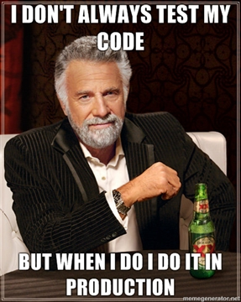
Tester Mindshift
“Stay buggy, my friends...”
“That's our motto here. Doesn't work to well in practice, actually. “
“Then blame all issues on QA -_- “
“you don't even have to hire testers....they're just called ‘clients’.”
Notes:
(photo credit: http://imgur.com/gallery/y7Hm9) - The most interesting man in the world – Pitch man for Dos Equis beer – original statement, “I don’t always drink beer, but when I do, I drink Dos Equis”
Likely that this poster is by a tester mocking “reckless” developers, probably working on a boxed product
Comments from the web on this picture support this
http://imgur.com/gallery/y7Hm9
http://www.reddit.com/r/pics/comments/gp2ti/i_dont_always_test_my_code/

Slide 7

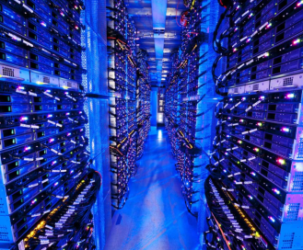
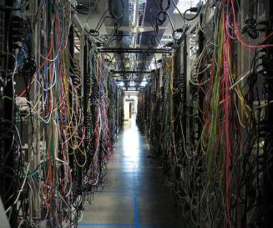
WhY do we TiP?
Leverage the diversity of real users
…and real prod environment…
…to find bugs you cannot find pre-production
Notes:
Do: Review the slide contents.
Say:
The previous definition have you the bare bones, but why do we TiP?
(click bullet 1) because it is difficult to simulate all behaviors for all users in a lab
(click, pic 1) because users are weird
(click, bullet 2) it is difficult to simulate your real world environment in a test lab
(click pic 2) because Data Centers are complex
(click bullet 3) therefore TiP finds bugs we would otherwise miss in pre-prod
For Azure hosted, the environment can be simulated, but simulation does not have:
Real traffic
Real dependent services
Real Scale

Slide 8

Why is TiP about Services?
You control the deployment independent of user action.
You have direct monitoring access.
Iterative Virtuous Cycle
Deploy
Detect
Remedy
Google: All engineers have access to the production machines: “…deploy, configure, monitor, debug, and maintain”
  [Google Talk, June 2007 @ 21:00]
Facebook: engineers must be present in a specific IRC channel for “roll call” before the release begins or else suffer a public “shaming”
  [Facebook ships, 2011]
Notes:
Here is how we defined services (first 2 bullets)
Generally only services enable this virtuous cycle. If you control the deployment, and you have access to see into the system, then you can catch problems early, fix them, and deploy the fixes
TiP leverages this cycle to get code in front of users sooner, find quality impacting issues, and improve quality
Additional examples from Amazon and Microsoft (big red button)

Slide 9
TiP A-Z
A | Active Monitoring | N | Not to Do, What
B | Big Data | O | Operations
C | Client Instrumentation | P | Performance Testing
D | Data Mining | Q | Quality Signal
E | Experimentation | R | Real Data Input
F | Fault Injection | S | Service, Effect on; Synthetic Data Input
G | Go / No-go for deployment | T | Three Stages
H | High Availability | U | Users, Experiment with
I | Iterative Virtuous Cycle | V | Validation in Data Center
J | JSI: J-script Instrumentation | W | Write Once, Test Anywhere
K | Kill production instances | X | eXposure Control
L | Load Testing in Production | Y | Y TiP?
M | Methodologies | Z | Zymurgy

Slide 10
Methodologies
The many ways we can TiP
Notes:
Methodologies
Three Stages

Slide 11
Ten Methodologies
Based on observation across Microsoft and Industry
Your team may categorize differently
Data Mining | Dogfood/beta
User Performance Testing | Synthetic Tests in Production
Environment Validation | User Scenario Execution
Experimentation for Design | Load Testing in Production
Controlled Test Flight | Destructive Testing
1
2
3
4
5
6
7
8
9
10

Slide 12
TiP Methodologies in Three Stages
Input
Effect
Observe
Input
  Where does the data driving your tests come from?
Effect
  Does the test change or act on production, and how?
Observation
  How do we measure the test results?
Notes:
Add Observe

Slide 13


TiP Methodologies – Inputs
  Where does the data driving your tests come from?
Real Data
Synthetic Data
Notes:
Synthetic Data: is created by the test. May try to approximate Real Data
Real Data is from actual users or systems
Brief mention of user versus system data

Slide 14
TiP Methodologies - Effects
  Does the test change or act on production, and how?
No Change
Experiment with Users
Act on or Change Service
Notes:
No Change: No perceivable effect on user experience or system intended (some unintended effect possible)
Experiment with Users: some or all end users can perceive a difference in behavior due to testing
Act on System: Test does something and system reacts. Reaction is within scope of normal operation
Change System: Test does something that alters a fundamental behavior of the system. Either at the edge of normal operating parameters or outside of them

Slide 15
TiP Methodologies - Observations
  How do we measure the test results?
User Behavior
System Behavior
Notes:
User Behavior: assess test through user actions: click through rate, usage patterns, usability reports
System Behavior asses test through system results: SLAs/KPIs, error rates, response latency, system recovery

Slide 16
Methodology | Inputs are… | Effect is… | We Observe…
Data Mining | Real User Data | None | User Behavior (also System Behavior)
User Performance Testing | Real User Data | None | System Behavior
Environment Validation | Real System Data | None | System Behavior
Experimentation for Design | Real User Data | Experiment with Users | User Behavior
Controlled Test Flight | Real User Data | Experiment with Users | System Behavior
Dogfood/beta | Real User Data | Experiment with Users | System Behavior (also User Behavior)
Synthetic Tests in Production | Synthetic User Data | Acting on System | System Behavior
User Scenario Execution | Synthetic User Data | Acting on System | System Behavior
Load Testing in Production | Synthetic User Data | Stress System | System Behavior
Destructive Testing | Synthetic System Data | Stress System | System Behavior
Notes:
***BREAK*****
This works better as a handout.
Can leave up if break here.

Slide 17
TiP A-Z
A | Active Monitoring | N | Not to Do, What
B | Big Data | O | Operations
C | Client Instrumentation | P | Performance Testing
D | Data Mining | Q | Quality Signal
E | Experimentation | R | Real Data Input
F | Fault Injection | S | Service, Effect on; Synthetic Data Input
G | Go / No-go for deployment | T | Three Stages
H | High Availability | U | Users, Experiment with
I | Iterative Virtuous Cycle | V | Validation in Data Center
J | JSI: J-script Instrumentation | W | Write Once, Test Anywhere
K | Kill production instances | X | eXposure Control
L | Load Testing in Production | Y | Y TiP?
M | Methodologies | Z | Zymurgy

Slide 18
Real Data Input
Notes:
Client Instrumentation
Data Mining
JSI: J-script Instrumentation
Performance Testing
Real Data Input

Slide 19
TiP Methodologies – Inputs
  Where does the data driving your tests come from?
Real Data
Synthetic Data
Notes:
Synthetic Data: is created by the test. May try to approximate Real Data
Real Data is from actual users or systems
Brief mention of user versus system data

Slide 20

Data Mining
1
Analysis of Real User Data
  Large Data Sets
  Real Usage Patterns
  Tease out the Defects
Different Approaches
  Real-time feedback loop
  Find patterns for humans to follow-up
Notes:
Advantages of services over Boxed product for DM
Less biased because users do not need to opt in
More data
Can choose what data you want after release
Real Time access - Can act on data in real time
Deeper more complete view of server level metrics

Slide 21
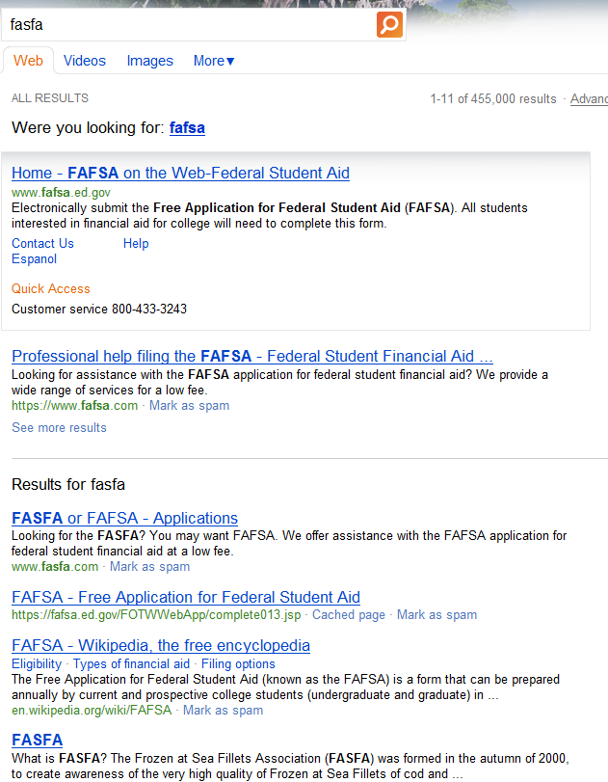
Data Mining: Speller Split Screen
Top Pane
Result 1 and Result 2 from Corrected Query
Bottom Pane
Results from Original Query
Notes:
- Speller Split Pane

Slide 22
Data Mining: Speller Split Screen
Split screen is a poor compromise
Want to do better:
  Just fix the spelling
  Or leave query as-is
Notes:
- Speller Split Pane

Slide 23
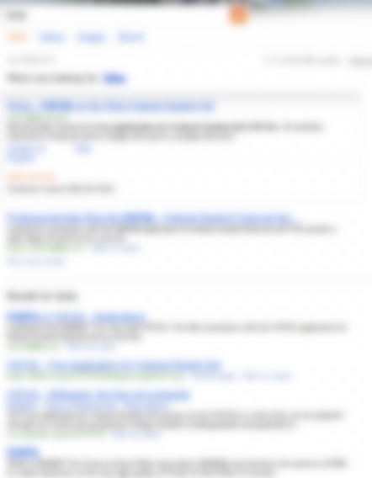
Data Mining: Speller Split Screen
Alter query…
If top pane clicks > 90%
Leave query as-is…
If bottom pane clicks > 90%
    [Unpingco, Feb 2011]
Notes:
Speller Split Pane
make it clearer that if >90% on one or the other then remove the split screen
Let’s us get rid of split screens when split screens are not appropriate

Slide 24
Data Mining: Speller Split Screen
Some Top Results
Query | Correction | Top Clicks | Bottom Clicks | Keep Original | Make Correction
yah | yahoo | 99.8% | 0.2% |  | ✓
fasfa | fafsa | 90.5% | 9.5% |  | ✓
utube music | youtube music | 90.4% | 9.6% |  | ✓
facebookcom | facebook.com | 98.4% | 1.6% |  | ✓
imbd | imdb | 96.3% | 3.7% |  | ✓
evony | ebony | 0.5% | 99.5% | ✓
century link | centrelink | 2.0% | 98.0% | ✓
yout | youth | 3.8% | 96.2% | ✓
Notes:
The more interesting ones are where the correction was bad
Evony is the name of an online game
Q={yout} are looking for youtube

Slide 25
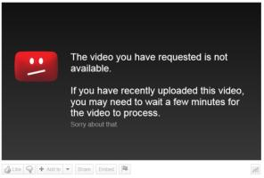
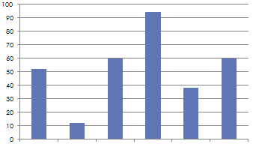
Detecting Video Takedown Pages
Video Histogram “Fingerprint”
Automated heuristic:
Most videos on a video site will play. Takedown pages look different; find outliers.
3.31% of our video results lead to a video takedown page.
5.56% of our YouTube videos lead to a video takedown page.
More than 80,000 users experience this per week.
We are feeding this back into the product!
Videos with takedown pages
Notes:
What is measured for the histogram? – that’s a secret – but It identifies quantifiable differences between good video and take-down video

Slide 26
User Performance Testing
2
Collect specific telemetry about how long stuff takes from user point of view
Real User Data – Real User Experience
End to End = complete request and response cycle
  From user to back-end round-trip
  Include traffic through CDN or data providers
  Measured from the user point of view
From around the world
From diversity of browsers, OS, devices
CDN – Content Data Network
Notes:
Can we focus DM on performance - yes
Stuff = (the next major bullet) PLT, time to submit, etc.

Slide 27
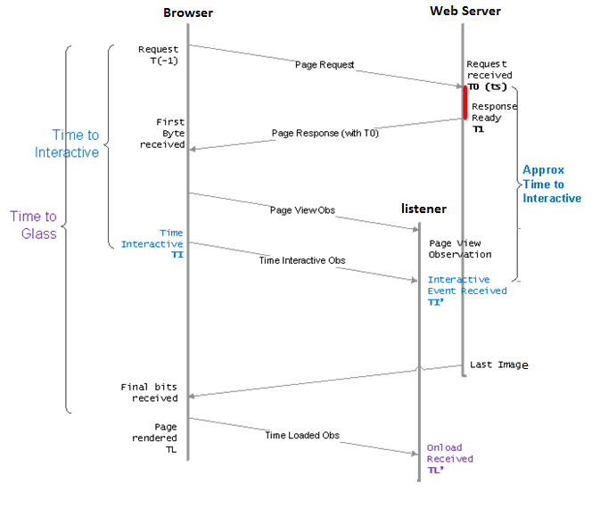
Stuff includes… Page Load Time (PLT)
TTG, real PLT for real users
Client Instr. sends Beacons
Notes:
Listener = service listening for the beacons from the client instrumentation

Slide 28
User Performance Testing
Collect specific telemetry about how long stuff takes
  Often requires Client Instrumentation
E2E = complete request and response cycle from user to SUT and back again
  Evaluation should include traffic through CDN or data providers
  Measured from the user point of origin via client side instrumentation
Collect PLT, time to submit, and other metrics at scale
  From around the world
  From diversity of browsers, OS, devices
Notes:
Can we focus DM on performance - yes
Stuff = (the next major bullet) PLT, time to submit, etc.

Slide 29
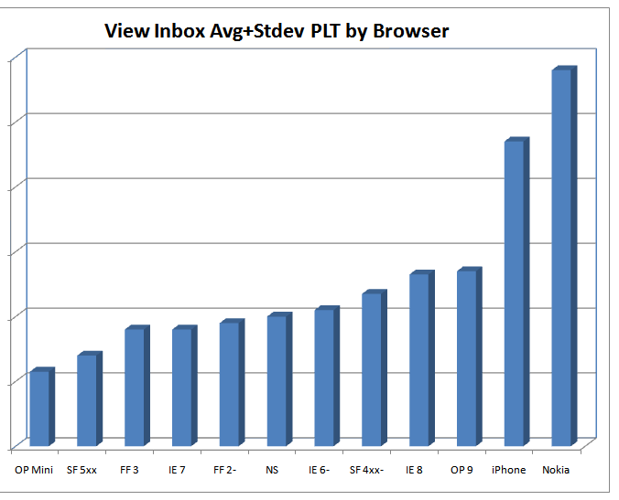
Hotmail JSI User Performance Testing
PLT by browser, OS, country, cluster, etc..
Customers do not care what we think our performance is
- Aladdin Nassar, Sr. PM Hotmail
Notes:
Say: Here are the actual results in the case.
Do: Explain the graphic on the slide.
PLT can vary by browser, as well as by other environmental factors
These analyses can show defects, bottlenecks, and usage patterns
Here iPhone and Nokia are expected to be slower since they are likely cellular broadband
Reveal: Nassar quote
- A test lab tells us what we think performance is….
Additional talking points:
Specifically Last-Mile performance testing with real users
They use a custom built solution: Hotmail's JavaScript Instrumentation (JSI)
Uses timers, cookies & c.gif’s to measure perf the way we want to
Budget for 500 Million measurements / month
Backend collection and analysis outsourced (Omniture, Akamai)
Sampled by market/cluster

Slide 30

User Performance Testing Examples
Hotmail
  Re-architected from the ground up around performance
  Read messages are 50% faster
Windows Azure™
  Every API: Tracks how many calls were made; how many succeeded, and how long each call took to process
Bing™ PerfPing
  Measures user perceived performance
    Measurement points occur at the client

Slide 31
Environment Validation
3
What is the most dangerous time for a service?
System = Service + Environment
Environment Validation checks…
  DLL/File version compatibility
  Connection Health
  Certificate Installation and Validity
  Content propagation across servers (freshness)
  Other…
Runs at deployment time
  Or, all the time (always)
Notes:
Change, such as deployment of new features/versions is the most dangerous time for a service
Services have a lot more change that packaged software - need to protect yourself for those changes
Environment Validation checks everything *outside* of your code

Slide 32
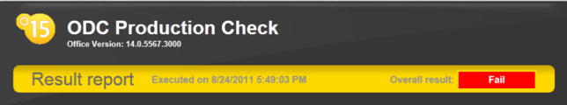
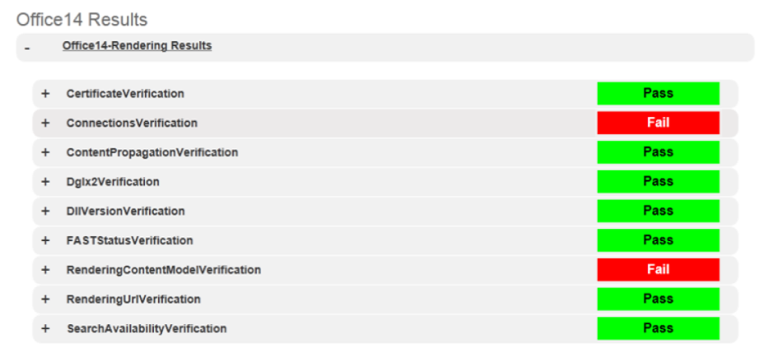
Environment Validation for Office.com
Notes:
Do: Paraphrase the actual case information below.
ODC Production Check is an automated verification tool that helps verify basic configuration and functionalities on OfficeCMS and Office.com web site.
DLL version compatibility
Connection Health
Certificate Installation and Validity
Content freshness
Consistent configuration across deployment
The tool can be run remotely and does not need to be run on the server, therefore all the tests are simple web request to the server and make sure they return OK.
Do: Ask for questions regarding the scenario and/or Environment Validation.

Slide 33
TiP Methodologies - Effects
  Does the test change or act on production, and how?
No Change
Experiment with Users
Act on or Change Service
Data Mining
User Perf. Testing
Environment Validation
Notes:
No Change: No perceivable effect on user experience or system intended (some unintended effect possible)
Experiment with Users: some or all end users can perceive a difference in behavior due to testing
Act on System: Test does something and system reacts. Reaction is within scope of normal operation
Change System: Test does something that alters a fundamental behavior of the system. Either at the edge of normal operating parameters or outside of them

Slide 34
TiP Methodologies - Inputs
  Where does the data driving your tests come from?
Real Data
Synthetic Data
User Performance Testing
Data Mining
Environment Validation
Notes:
Give 30 seconds for participants to compare their answers to this
Then ask for questions

Slide 35
TiP A-Z
A | Active Monitoring | N | Not to Do, What
B | Big Data | O | Operations
C | Client Instrumentation | P | Performance Testing
D | Data Mining | Q | Quality Signal
E | Experimentation | R | Real Data Input
F | Fault Injection | S | Service, Effect on; Synthetic Data Input
G | Go / No-go for deployment | T | Three Stages
H | High Availability | U | Users, Experiment with
I | Iterative Virtuous Cycle | V | Validation in Data Center
J | JSI: J-script Instrumentation | W | Write Once, Test Anywhere
K | Kill production instances | X | eXposure Control
L | Load Testing in Production | Y | Y TiP?
M | Methodologies | Z | Zymurgy

Slide 36

Experiment with Users
Notes:
Users, Experiment with
Experimentation
Go / No-go
eXposure Control

Slide 37
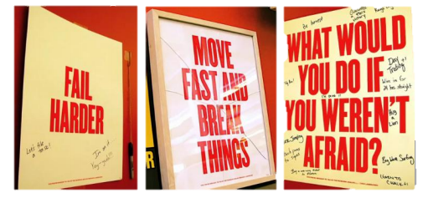

Experimentation
“To have a great idea, have a lot of them”
-- Thomas Edison
Try new things… in production
Build on Successes
Cut your losses… before they get expensive
  A/B Testing - aka Controlled Experimentation
  Un-Controlled Experimentation
Notes:
“new things” = ideas, either customer facing or deep architectural
TiP enables Experimentation
Experimentation
Uncontrolled Experimentation
Dogfood
Controlled Experimentation (AB Testing)
Experimentation for Design
Experimentation for Quality

Slide 38

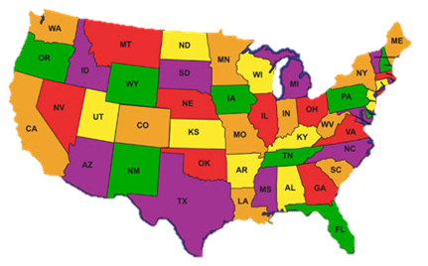




Mitigate Risk with eXposure Control
Launch a new Service – Everyone sees it
Exposure Control – only some see it
By Browser
By Location
By Percent
(scale)
Notes:
Cheap and rapid – limit testing / limit risk

Slide 39


Who’s doing Exposure Control?
Three concentric push phases [Facebook ships, 2011]
  p1 = internal release
  p2 = small external release
  p3 = full external release
“We do these 1% launches where we float something out and measure that. We can dice and slice in any way you can possibly fathom.”
-Eric Schmidt, former CEO, Google
[Google BusinessWeek, April 2008]

Slide 40
A/B Testing
Aka: Controlled Online Experimentation
Notes:
Say: A subset of experimentation is *controlled* experimentation, known as AB Testing
Do
Explain how AB Testing works
Describe why it is controlled – how it proves causality of your observed results

Slide 41
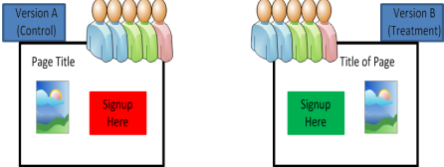
AB Testing: Two Different TiP Methodologies
4
Experimentation for Design
  Business Metrics – Did we build the right thing?
Controlled Test Flight
  Assess quality of new code →deployment Go/No-go
  Code Quality Metrics –
          Did we build it right?
5
Notes:
Say: Now back to our two methodologies – they are both forms of AB Testing

Slide 42
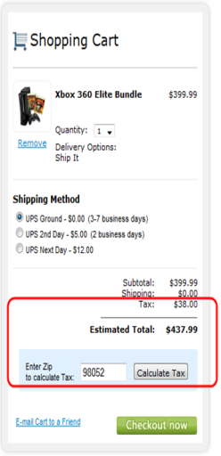
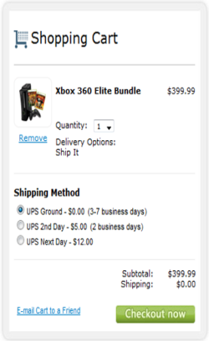
Experimentation for Design
Example: Microsoft Store
Goal: Increase Average Revenue per User
A
B
Which increased revenue…?
Control
Treatment
Neither
Which increased revenue…?
Control
Treatment – up 3.3%
Neither
http://store.microsoft.com/home.aspx
Notes:
Website/UX
July 2009
Defer Tax calculation

Slide 43
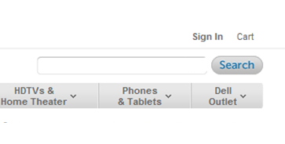
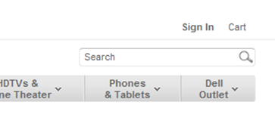
Experimentation for Design
Example: Dell
A
Which Increased Revenue Per Visitor?
Control
Treatment
Neither
Which Increased Revenue Per Visitor?
Control – up 6.3%
Treatment
Neither
B
[Dell, 2012]
Notes:
http://whichtestwon.com/dell%e2%80%99s-site-wide-search-box-test

Slide 44
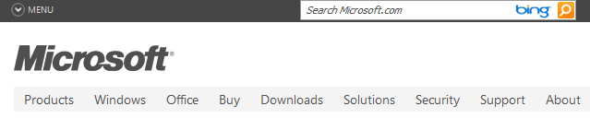
Example: Controlled Test Flight – Microsoft.com
Microsoft.com
  Put a single server with v-next in production
  Monitor the server and applications hosted on the server
  Capture traffic, volume, performance, and availability
  Pull it back out and “crawl” the logs
No Functional difference observable by user
Not always truly random and un-biased
[Microsoft.com, TechNet]
Notes:
http://technet.microsoft.com/en-us/library/cc627315.aspx
Although not truly random and un-biased, there is still value here, especially to see large changes
Can also mention IMVU example here

Slide 45
Example Controlled Test Flight : Amazon ordering pipeline
Amazon's ordering pipeline (checkout) systems were migrated to a new platform.
Team had tested and was going to launch.
Quality advocates asked for a limited user test using Exposure Control.
Five Launches and Five Experiments until A=B (showed no difference.)
The cost had it launched initially to the 100% users could have easily been in the millions of dollars of lost orders.
Fail
Fail
Fail
Fail
Pass
Notes:
Many services tests are A/B where you hope to show no statistically significant difference, i.e., A=B
Dev’s did not produce bad quality – Production Systems need Production Testing.

Slide 46
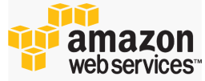
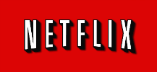
Example: Controlled Test Flight – Netflix
Deployed to the Cloud (AWS)
Developers use web based portal to deploy new code alongside old code
  Put one "canary" instance into traffic
Go / No-Go
  If Go, then old instances removed automatically
[Cockcroft, March 2012]
Notes:
Cockcroft says Netflix calls this “NoOps” (as opposed to DevOps)

Slide 47
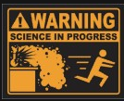
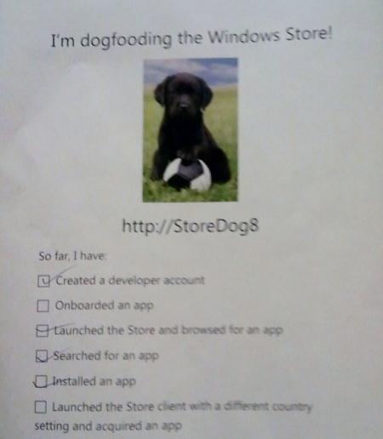
Un-Controlled Experimentation
6
Dogfood and Beta
Different from AB Testing:
  Users opt-in; users know!
  Active Feedback (also telemetry)
Dogfood vs. Beta
  DF: Providers use own product
  Beta: limited general audience usage

Slide 48
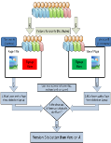


The Experimentation Family
Experimentation
Controlled
(A/B Testing)
Uncontrolled
Experimentation for Design
Controlled Test Flight
Dogfood/
Beta
Business
Code Quality

Slide 49
TiP Methodologies - Inputs
  Where does the data driving your tests come from?
Real Data
Synthetic Data
User Performance Testing
Controlled Test Flight
Dogfood/beta
Data Mining
Experimentation for Design
Environment Validation
Notes:
Give 30 seconds for participants to compare their answers to this
Then ask for questions

Slide 50
TiP Methodologies - Effects
  Does the test change or act on production, and how?
No Change
Experiment with Users
Act on or Change Service
Data Mining
User Perf. Testing
Environment Validation
Experim. for Design
Controlled Test Flight
Dogfood/Beta
Notes:
No Change: No perceivable effect on user experience or system intended (some unintended effect possible)
Experiment with Users: some or all end users can perceive a difference in behavior due to testing
Act on System: Test does something and system reacts. Reaction is within scope of normal operation
Change System: Test does something that alters a fundamental behavior of the system. Either at the edge of normal operating parameters or outside of them

Slide 51
TiP A-Z
A | Active Monitoring | N | Not to Do, What
B | Big Data | O | Operations
C | Client Instrumentation | P | Performance Testing
D | Data Mining | Q | Quality Signal
E | Experimentation | R | Real Data Input
F | Fault Injection | S | Service, Effect on; Synthetic Data Input
G | Go / No-go for deployment | T | Three Stages
H | High Availability | U | Users, Experiment with
I | Iterative Virtuous Cycle | V | Validation in Data Center
J | JSI: J-script Instrumentation | W | Write Once, Test Anywhere
K | Kill production instances | X | eXposure Control
L | Load Testing in Production | Y | Y TiP?
M | Methodologies | Z | Zymurgy

Slide 52
Synthetic Data Input
&
Effect on Service
Notes:
Active Monitoring
Service - Effect;
Synthetic Data Input
Write Once, Test Anywhere

Slide 53

TiP Test Execution
7
Synthetic Tests in Production
  Automation
  Against internal APIs
User Scenario Execution
  From User Entry Point- Synthetic Transactions
  E2E Scenario in Production
  Automation or….
  Manual
8
Notes:
uTest

Slide 54
Synthetic Data / Effect on Service
Synthetic Data
SUT
Service Responds
Test Result
Pass
Fail
Attempt
Login
Effect:
Acts on Service
SUT
System (Service) Under Test

Slide 55
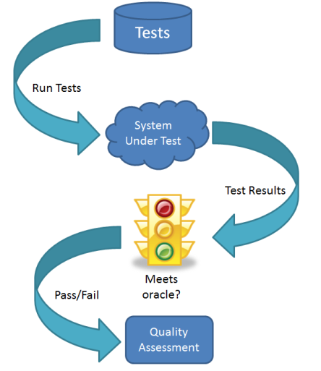
Synthetic Data / Effect on Service
Create new user:
testuser123
Synthetic
Data
Effect:
Acts on Service
Denied
Name already taken
Notes:
What is Synthetic Data? - Test generates the data
What does it mean to “Act on Service”? – Apply a stimulus to the service, and it reacts – within normal operating conditions

Slide 56
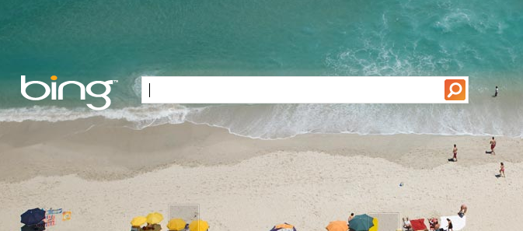

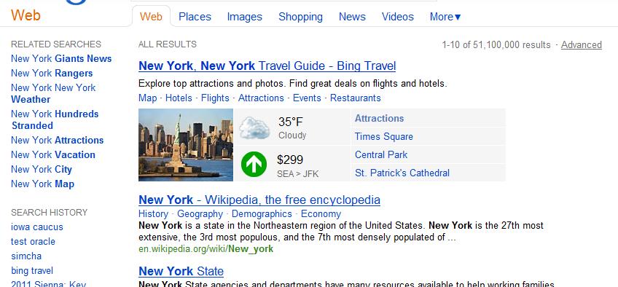
User Scenario Execution: BingSAM
BingSAM
Test
Query
New York
Validator
Result
Notes:
Executes queries like a user would
Just like a user would
Synthetic Transactions
Automated execution and rich validation capabilities
String match / RegEx
C# Validator
Alerting / Reporting

Slide 57
Google Staged Approach
Risk Mitigation Index (RMI): the risk of the failing functionality of a product.
Up-Front Test
  Internal testers, lower the risk from 100% to 91%.
User Scenario Execution
  Crowd-sourcing such as uTest, to get to 60%
Dogfood
  Released to dog-fooders, get risk down to 48%.
Beta
  Beta version is released
[Google GTAC 2010]

Slide 58
Who’s Right?
“These are some number of bugs that simply cannot be found until the house is lived in and software is no different. It needs to be in the hands of real users doing real work with real data in real environments”
James Whittaker, Former Engineering Director, Google
[Google, JW 2009]
[It’s a mistake to assume] all users are early adopters with excellent technical ability
Jon Bach, Director of Live Site Quality, eBay
[STPCon, 2012]
Notes:
Both are right - we as testers make this user interaction a conscientious part of our test strategy.

Slide 59






Test Data Handling
Synthetic Tests + Real Data = Potential Trouble
  Avoid it
  Tag it
  Clean it up
Example: Facebook Test Users
Cannot interact with real users
Can only friend other Test Users
Create 100s
Programmatic Control
Notes:
Tag it so it can be either
Recognized by the production system
Backed out by a clean-up process
http://developers.facebook.com/blog/post/527/

Slide 60

Write Once, Test Anywhere
Microsoft Exchange
  70,000 automated test cases in lab
  Re-engineered to run from the cloud
TiP Execution Framework
  Test Harness runs tests from Azure Cloud Platform
Exchange measured performance
  Latency: baseline, and measured over time
  How….?
[Deschamps, Johnston, Jan 2012]

Slide 61
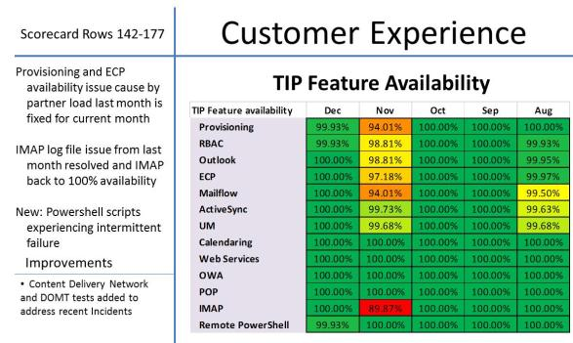
Active Monitoring
Microsoft Exchange
  Instead of pass/fail signal look at thousands of continuous runs.
    Did we meet the "five nines" (99.999%) availability?
    Did we complete the task in less than 2 seconds 99.9% of the time? - performance
[Deschamps, Johnston, Jan 2012]
Notes:
Active Monitoring: uses synthetic data and scenarios to assess system health

Slide 62
More Testing, Less Cost
Write Once, Test Anywhere
Active Monitoring
ROI
Test Re-Use
Performance
Availability
Notes:
For an incremental up-front cost
re-use tests you already have in lab, pre-prod, and prod
Use tests as monitors in addition to as tests – performance
Less Cost/Effort

Slide 63
TiP Methodologies - Inputs
  Where does the data driving your tests come from?
Real Data
Synthetic Data
User Perf Testing
Controlled Test Flight
Dogfood/beta
Synthetic Tests in Production
User Scenario Execution
Data Mining
Experimentation for Design
Environment Validation

Slide 64
TiP Methodologies - Effects
  Does the test change or act on production, and how?
No Change
Experiment with Users
Act on or Change Service
Data Mining
User Perf. Testing
Environment Validation
Experim. for Design
Controlled Test Flight
Dogfood/Beta
Synthetic TiP
User Scenario Execution
Notes:
No Change: No perceivable effect on user experience or system intended (some unintended effect possible)
Experiment with Users: some or all end users can perceive a difference in behavior due to testing
Act on System: Test does something and system reacts. Reaction is within scope of normal operation
Change System: Test does something that alters a fundamental behavior of the system. Either at the edge of normal operating parameters or outside of them

Slide 65
TiP A-Z
A | Active Monitoring | N | Not to Do, What
B | Big Data | O | Operations
C | Client Instrumentation | P | Performance Testing
D | Data Mining | Q | Quality Signal
E | Experimentation | R | Real Data Input
F | Fault Injection | S | Service, Effect on; Synthetic Data Input
G | Go / No-go for deployment | T | Three Stages
H | High Availability | U | Users, Experiment with
I | Iterative Virtuous Cycle | V | Validation in Data Center
J | JSI: J-script Instrumentation | W | Write Once, Test Anywhere
K | Kill production instances | X | eXposure Control
L | Load Testing in Production | Y | Y TiP?
M | Methodologies | Z | Zymurgy

Slide 66
Validate the Data Center
And the Service
Notes:
Fault Injection
High Availability
Kill production instance
Load Testing in Production
Operations
Validate the Data Center

Slide 67

Load Testing in Production
9
Injects load on top of real user traffic
Monitors for performance
Employs alert and back-off protections
Load should not go through CDN or data providers
Identified major datacenter power issue
From
  30 Engineers on a con-call
To
  1.5 engineers and a framework

Slide 68
Operations
“Ops” runs the data center
Ops needs to be in the loop on TiP
  Else they may react as if a real problem were occurring
Ops traditionally does monitoring
  TiP is synergistic - TestOps
  …but need to define roles and responsibilities

Slide 69
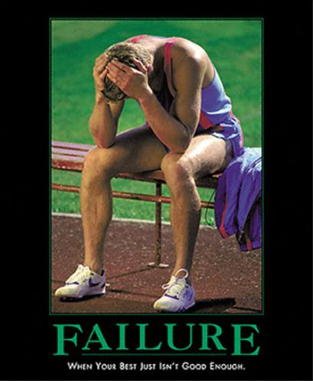
Destructive Testing in Production
10
Google first year of a new data center
  20 rack failures, 1000 server failures and thousands of hard drive failures
[Google DC, 2008]
High Availability means you must Embrace Failure
  How do you test this?

Slide 70




AWS Cloud Failure – April 2011
Amazon AWS EC2/RDS Outage
Took down
But one website had reason to be Smug
  …minimally impacted, and all major services remained online during the AWS outage
Netflix stayed up too…
  Any of our instances….can be “shot in the head” and our system will recover (with some caveats – but they’re known, understood, and tested)
  - Don MacAskill, CEO SmugMug

Slide 71



Netflix Tests its “Rambo Architecture”
  …system has to be able to succeed, no matter what, even all on its own
Test with Fault Injection
Netflix Simian Army
  Chaos monkey randomly kills production instance in AWS
  Chaos Gorilla simulates an outage of an entire Amazon AZ
  Janitor Monkey, Security Monkey, Latency Monkey…..
[Netflix Army, July 2011]
Notes:
Comment: surprisingly easy to find images of monkeys with rifles

Slide 72

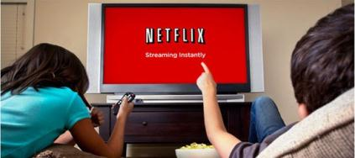

Slide 73
Effect: Change Service
Load to Capacity
Create new user:
testuser123
Inject System Fault
Effect:
Change
Service
Effect:
Acts on Service
Effect:
Change
Service
System performance impacted
Denied
Name already taken
Fault tolerance features engaged
Notes:
What is Synthetic Data?
What does it mean to “Act on Service”?

Slide 74
TiP Methodologies - Effects
  Does the test change or act on production, and how?
No Change
Experiment with Users
Act on or Change Service
Data Mining
User Perf. Testing
Environment Validation
Experim. for Design
Controlled Test Flight
Dogfood/Beta
Synthetic TiP
User Scenario Execution
Load TiP
Destructive Testing
Notes:
No Change: No perceivable effect on user experience or system intended (some unintended effect possible)
Experiment with Users: some or all end users can perceive a difference in behavior due to testing
Act on System: Test does something and system reacts. Reaction is within scope of normal operation
Change System: Test does something that alters a fundamental behavior of the system. Either at the edge of normal operating parameters or outside of them

Slide 75

How Did SmugMug Do It?
Reward
Risk
Mitigation
Availability Zones (AZs)
Failures Should Not Span AZs
  In this case they did!
SmugMug uses Three AZs
Designed to fail and recover
  Any of our instances, or any group of instances in an AZ, can be “shot in the head” [SmugMug April 2011]
Incident Response
  We updated our own status board, and then I tried to work around the problem…. 5 minutes [later] we were back in business
Notes:
Included as background on how SmugMug designs for failure (fault tolerance)

Slide 76
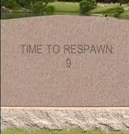
Embrace Failure
Reward
Risk
Mitigation
Design For Failure
Each System has to succeed, even on its own
  Small Stateless Services
  Recommendation System Down? Show popular titles instead of personalized picks
Assume host failures happen
  Remember, “shot in the head”
  Cloud Advantage: Re-Spawn!
Short Timeouts and Quick Retries – Fail Fast
  Co-tenancy can introduce variance in throughput at any level of the stack.
  Requires Idempotent Interfaces
Research and Test with Full Scale / Real Data
  Cloud Advantage: Elasticity
[Netflix AWS, Dec 2010]
[Twilio AWS, Apr 2011]
Notes:
Included as background on how SmugMug and others design for failure (fault tolerance)

Slide 77
TiP A-Z
A | Active Monitoring | N | Not to Do, What
B | Big Data | O | Operations
C | Client Instrumentation | P | Performance Testing
D | Data Mining | Q | Quality Signal
E | Experimentation | R | Real Data Input
F | Fault Injection | S | Service, Effect on; Synthetic Data Input
G | Go / No-go for deployment | T | Three Stages
H | High Availability | U | Users, Experiment with
I | Iterative Virtuous Cycle | V | Validation in Data Center
J | JSI: J-script Instrumentation | W | Write Once, Test Anywhere
K | Kill production instances | X | eXposure Control
L | Load Testing in Production | Y | Y TiP?
M | Methodologies | Z | Zymurgy

Slide 78
Methodology Wrap-up

Slide 79
TiP Methodologies - Inputs
  Where does the data driving your tests come from?
Real Data
Synthetic Data
User Perf Testing
Controlled Test Flight
Dogfood/beta
Destructive Testing
Synthetic Tests in Production
User Scenario Execution
Load Testing in Production
Data Mining
Experimentation for Design
Environment Validation

Slide 80
TiP Methodologies - Effects
  Does the test change or act on production, and how?
No Change
Experiment with Users
Act on or Change Service
Data Mining
User Perf. Testing
Environment Validation
Experim. for Design
Controlled Test Flight
Dogfood/Beta
Synthetic TiP
User Scenario Execution
Load TiP
Destructive Testing
Notes:
No Change: No perceivable effect on user experience or system intended (some unintended effect possible)
Experiment with Users: some or all end users can perceive a difference in behavior due to testing
Act on System: Test does something and system reacts. Reaction is within scope of normal operation
Change System: Test does something that alters a fundamental behavior of the system. Either at the edge of normal operating parameters or outside of them

Slide 81
TiP Methodologies - Observations
  How do we measure the test results?
User Behavior
System Behavior
Data Mining
(Dogfood/Beta)
Experimentation for Design
User Performance Testing Controlled Test Flight Dogfood/beta Load Testing in Production | Destructive Testing Environment Validation Synthetic Tests in Production User Scenario Execution
Notes:
Give 30 seconds for participants to compare their answers to this
Then ask for questions

Slide 82
Real Users / Live Environments
…utilizes real users and/or live environments ….
…utilizes real users and live environments ….
Real Users
Real Users / Live Environment
Real Users
Live Environment
TiP-like activities
Data Mining
User Performance Testing
Experimentation for Design
Controlled Test Flight
Dogfood/beta
Environment Validation
Synthetic Tests in Production
User Scenario Execution
Load Testing in Production
Destructive Testing
Record & Playback
Test lab in prod data center
Test in Cloud (TiC)
Live Environment
Notes:
Say:
TiP is about real users and live environments
But to be clear, TiP methodologies may not always employ both
There is high value, even when not using both
Notes:
even if test does not use real users directly, it is using the live environment which has live users in it
V1 Betas are often in the live environment (and are the only version of the product available)

Slide 83
Changing the
Quality Signal
Notes:
Big Data
Quality Signal

Slide 84
Traditional Quality Signal

Slide 85
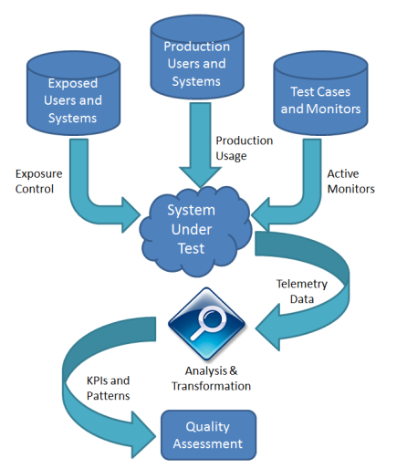
Big Data Quality Signal
aka TestOps
KPI: Key Performance Indicator
Request latency
RPS
Availability / MTTR
Notes:
KPI: Key Performance Indicator

Slide 86
How Big?
Google: more than 3 billion searches, 2 billion video replays and absorbs 24 hours of video per minute.
Microsoft Bing has grown from 10% of U.S. Searches in September 2010 to over 30% as of April 2011
  Cosmos ingests 1-2 PB/day
Facebook: 800 million active users sharing 30 billion pieces of content per month.
Amazon: more than 120 million user accounts, 2 million sellers and 262 billion objects stored in its S3 cloud storage system.
Twitter reached its one-billionth tweet after just 3 years, 2 months and 1 day.
Notes:
http://searchengineland.com/by-the-numbers-twitter-vs-facebook-vs-google-buzz-36709
http://mashable.com/2011/04/11/bing-search-growth/
http://perspectives.mvdirona.com/2011/10/25/MicrosoftCOSMOSAtHPTS.aspx
http://www.facebook.com/press/info.php?statistics
http://www.businessweek.com/magazine/content/10_49/b4206039292096.htm
http://blog.twitter.com/2011/03/numbers.html

Slide 87
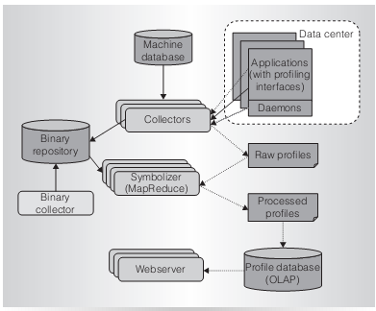
Google-Wide Profiling (GWP)
Continuous profiling infrastructure for data centers - draw performance insights
Collects stack traces, hardware events, kernel events etc.,
From several thousand applications running on thousands of servers
Compressed profile database grows by several GB every day.
What are the hottest processes, routines, or code regions?
How does performance differ across software versions?
Which locks are most contended?
[Google-Wide Profiling, 2010]

Slide 88
TiP A-Z
A | Active Monitoring | N | Not to Do, What
B | Big Data | O | Operations
C | Client Instrumentation | P | Performance Testing
D | Data Mining | Q | Quality Signal
E | Experimentation | R | Real Data Input
F | Fault Injection | S | Service, Effect on; Synthetic Data Input
G | Go / No-go for deployment | T | Three Stages
H | High Availability | U | Users, Experiment with
I | Iterative Virtuous Cycle | V | Validation in Data Center
J | JSI: J-script Instrumentation | W | Write Once, Test Anywhere
K | Kill production instances | X | eXposure Control
L | Load Testing in Production | Y | Y TiP?
M | Methodologies | Z | Zymurgy

Slide 89
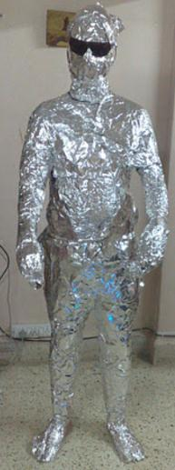

What NOT to Wear!
Notes:
This is a gag slide leading into the “What not to do” section

Slide 90
What Not to Do
Notes:
Not to Do, What

Slide 91
Tester mindshift
“Stay buggy, my friends...”
“That's our motto here. Doesn't work to well in practice, actually. “
“Then blame all issues on QA -_- “
“you don't even have to hire testers....they're just called ‘clients’.”
Notes:
(photo credit: http://imgur.com/gallery/y7Hm9) - The most interesting man in the world – Pitch man for Dos Equis beer – original statement, “I don’t always drink beer, but when I do, I drink Dos Equis”
Likely that this poster is by a tester mocking “reckless” developers, probably working on a boxed product
Comments from the web on this picture support this
http://imgur.com/gallery/y7Hm9
http://www.reddit.com/r/pics/comments/gp2ti/i_dont_always_test_my_code/

Slide 92

TiP is a common and costly technical malpractice
“Simply, you should have a separate test system that is identical to your production system”
If you do not have the resources for this, instead maintain:
  a scaled-down environment with load generators that duplicate the expected load.
  a model or simulation of the environment.
“One mistake in particular was that the bank had created two application servers on a single installation of WebSphere Application Server base”
Because both [prod and test]… ran on the same base WebSphere Application Server
  their logs are shared
  any upgrade to the SDK would disrupt both application servers
  [IBM, 2011]
Notes:
Maybe the Industry agrees with the negative assessment of TiP….
But IBM is criticizing TiP done wrong – reveal bottom text
Any TiP that regularly disrupts production is wrong
http://www.ibm.com/developerworks/websphere/techjournal/1102_supauth/1102_supauth.html

Slide 93
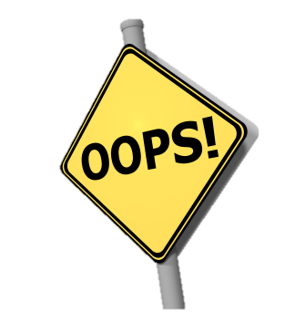
What Not to Do, IBM
Disrupt user experience introduced by testing: for example: outages
Failure to understand the production environment and the effect of TiP on it.
Co-mingling/corrupting production data
Notes:
Say: We’ll take a look at a few examples of anti-patterns.
Click to reveal each practice
Do: Briefly explain the slide contents.

Slide 94
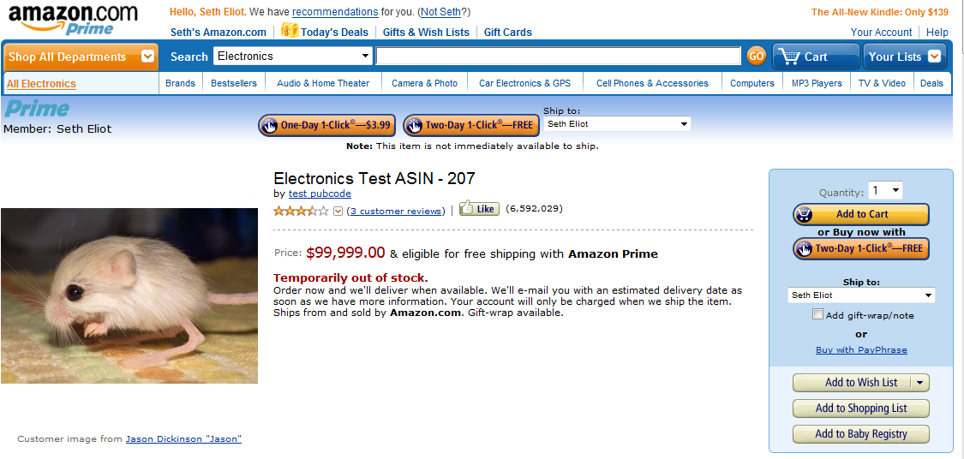
Wireless Mouse?
Notes:
Say: Here is a page found on the production Amazon website. Tester used a huge price to discourage real users from purchasing.
Ask: What is the anti-pattern? [answer: unnecessary test artifact exposure; possible effects on business metrics and business partners (if sale is made)]
Ask: What is the risk of this approach? [answer: This approach can backfire if purchase is made; Users see quality issues]

Slide 95
What Not to Do, Amazon
Exposure of test artifacts to end users: e.g. exposed test items, test emails sent
Misuse of PII customer data
Leaking sensitive new features prior to official launch
Notes:
The Amazon Digital Video sneak peak example:
(http://www.kokogiak.com/gedankengang/2006/08/amazons-digital-video-sneak-peek.html)
The link leads to a blogger who posted screen shots of the Amazon Digital Video store BEFORE it was launched
Amazon was using exposure control so only Amazon employees could see the new store, but the blogger was able to work around this and get to the sensitive info, leaking the launch.

Slide 96
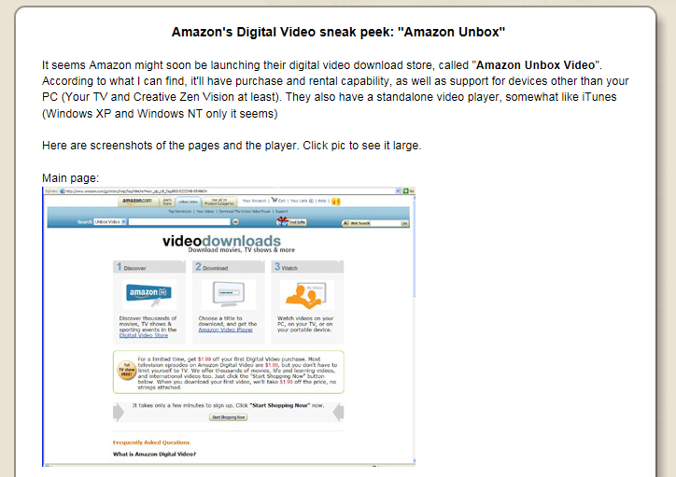
Amazon's Digital Video sneak peek
[Kokogiak, 2006]

Slide 97
TiP A-Z
A | Active Monitoring | N | Not to Do, What
B | Big Data | O | Operations
C | Client Instrumentation | P | Performance Testing
D | Data Mining | Q | Quality Signal
E | Experimentation | R | Real Data Input
F | Fault Injection | S | Service, Effect on; Synthetic Data Input
G | Go / No-go for deployment | T | Three Stages
H | High Availability | U | Users, Experiment with
I | Iterative Virtuous Cycle | V | Validation in Data Center
J | JSI: J-script Instrumentation | W | Write Once, Test Anywhere
K | Kill production instances | X | eXposure Control
L | Load Testing in Production | Y | Y TiP?
M | Methodologies | Z | Zymurgy

Slide 98
Summary
The latest version of this slide deck can be found at:
http://bit.ly/seth_stp_2012

Slide 99
Summary
A | Active Monitoring | N | Not to Do, What
B | Big Data | O | Operations
C | Client Instrumentation | P | Performance Testing
D | Data Mining | Q | Quality Signal
E | Experimentation | R | Real Data Input
F | Fault Injection | S | Service, Effect on; Synthetic Data Input
G | Go / No-go for deployment | T | Three Stages
H | High Availability | U | Users, Experiment with
I | Iterative Virtuous Cycle | V | Validation in Data Center
J | JSI: J-script Instrumentation | W | Write Once, Test Anywhere
K | Kill production instances | X | eXposure Control
L | Load Testing in Production | Y | Y TiP?
M | Methodologies | Z | Zymurgy

Slide 100
Summary
A | Active Monitoring | N | Not to Do, What
B | Big Data | O | Operations
C | Client Instrumentation | P | Performance Testing
D | Data Mining | Q | Quality Signal
E | Experimentation | R | Real Data Input
F | Fault Injection | S | Service, Effect on; Synthetic Data Input
G | Go / No-go for deployment | T | Three Stages
H | High Availability | U | Users, Experiment with
I | Iterative Virtuous Cycle | V | Validation in Data Center
J | JSI: J-script Instrumentation | W | Write Once, Test Anywhere
K | Kill production instances | X | eXposure Control
L | Load Testing in Production | Y | Y TiP?
M | Methodologies | Z | Zymurgy

Slide 101
Summary
A | Active Monitoring | N | Not to Do, What
B | Big Data | O | Operations
C | Client Instrumentation | P | Performance Testing
D | Data Mining | Q | Quality Signal
E | Experimentation | R | Real Data Input
F | Fault Injection | S | Service, Effect on; Synthetic Data Input
G | Go / No-go for deployment | T | Three Stages
H | High Availability | U | Users, Experiment with
I | Iterative Virtuous Cycle | V | Validation in Data Center
J | JSI: J-script Instrumentation | W | Write Once, Test Anywhere
K | Kill production instances | X | eXposure Control
L | Load Testing in Production | Y | Y TiP?
M | Methodologies | Z | Zymurgy

Slide 102
Summary
A | Active Monitoring | N | Not to Do, What
B | Big Data | O | Operations
C | Client Instrumentation | P | Performance Testing
D | Data Mining | Q | Quality Signal
E | Experimentation | R | Real Data Input
F | Fault Injection | S | Service, Effect on; Synthetic Data Input
G | Go / No-go for deployment | T | Three Stages
H | High Availability | U | Users, Experiment with
I | Iterative Virtuous Cycle | V | Validation in Data Center
J | JSI: J-script Instrumentation | W | Write Once, Test Anywhere
K | Kill production instances | X | eXposure Control
L | Load Testing in Production | Y | Y TiP?
M | Methodologies | Z | Zymurgy

Slide 103
Summary
A | Active Monitoring | N | Not to Do, What
B | Big Data | O | Operations
C | Client Instrumentation | P | Performance Testing
D | Data Mining | Q | Quality Signal
E | Experimentation | R | Real Data Input
F | Fault Injection | S | Service, Effect on; Synthetic Data Input
G | Go / No-go for deployment | T | Three Stages
H | High Availability | U | Users, Experiment with
I | Iterative Virtuous Cycle | V | Validation in Data Center
J | JSI: J-script Instrumentation | W | Write Once, Test Anywhere
K | Kill production instances | X | eXposure Control
L | Load Testing in Production | Y | Y TiP?
M | Methodologies | Z | Zymurgy

Slide 104
Summary
A | Active Monitoring | N | Not to Do, What
B | Big Data | O | Operations
C | Client Instrumentation | P | Performance Testing
D | Data Mining | Q | Quality Signal
E | Experimentation | R | Real Data Input
F | Fault Injection | S | Service, Effect on; Synthetic Data Input
G | Go / No-go for deployment | T | Three Stages
H | High Availability | U | Users, Experiment with
I | Iterative Virtuous Cycle | V | Validation in Data Center
J | JSI: J-script Instrumentation | W | Write Once, Test Anywhere
K | Kill production instances | X | eXposure Control
L | Load Testing in Production | Y | Y TiP?
M | Methodologies | Z | Zymurgy

Slide 105
Summary
A | Active Monitoring | N | Not to Do, What
B | Big Data | O | Operations
C | Client Instrumentation | P | Performance Testing
D | Data Mining | Q | Quality Signal
E | Experimentation | R | Real Data Input
F | Fault Injection | S | Service, Effect on; Synthetic Data Input
G | Go / No-go for deployment | T | Three Stages
H | High Availability | U | Users, Experiment with
I | Iterative Virtuous Cycle | V | Validation in Data Center
J | JSI: J-script Instrumentation | W | Write Once, Test Anywhere
K | Kill production instances | X | eXposure Control
L | Load Testing in Production | Y | Y TiP?
M | Methodologies | Z | Zymurgy

Slide 106
Summary
A | Active Monitoring | N | Not to Do, What
B | Big Data | O | Operations
C | Client Instrumentation | P | Performance Testing
D | Data Mining | Q | Quality Signal
E | Experimentation | R | Real Data Input
F | Fault Injection | S | Service, Effect on; Synthetic Data Input
G | Go / No-go for deployment | T | Three Stages
H | High Availability | U | Users, Experiment with
I | Iterative Virtuous Cycle | V | Validation in Data Center
J | JSI: J-script Instrumentation | W | Write Once, Test Anywhere
K | Kill production instances | X | eXposure Control
L | Load Testing in Production | Y | Y TiP?
M | Methodologies | Z | Zymurgy

Slide 107
Summary
A | Active Monitoring | N | Not to Do, What
B | Big Data | O | Operations
C | Client Instrumentation | P | Performance Testing
D | Data Mining | Q | Quality Signal
E | Experimentation | R | Real Data Input
F | Fault Injection | S | Service, Effect on; Synthetic Data Input
G | Go / No-go for deployment | T | Three Stages
H | High Availability | U | Users, Experiment with
I | Iterative Virtuous Cycle | V | Validation in Data Center
J | JSI: J-script Instrumentation | W | Write Once, Test Anywhere
K | Kill production instances | X | eXposure Control
L | Load Testing in Production | Y | Y TiP?
M | Methodologies | Z | Zymurgy

Slide 108
Time for a Beer…
Zymurgy
  zy·mur·gy (z mûr j) n. The branch of chemistry that deals with fermentation processes, as in brewing.

Slide 109
References
[Google Talk, June 2007] | Google: Seattle Conference on Scalability: Lessons In Building Scalable Systems, Reza Behforooz http://video.google.com/videoplay?docid=6202268628085731280
[Unpingco, Feb 2011] | Edward Unpingco; Bug Miner; Internal Microsoft Presentation, Bing Quality Day
[Barranco, Dec 2011] | René Barranco; Heuristics-Based Testing; Internal Microsoft Presentation
[Dell, 2012] | http://whichtestwon.com/dell%e2%80%99s-site-wide-search-box-test
[Microsoft.com, TechNet] | http://technet.microsoft.com/en-us/library/cc627315.aspx
[Cockcroft, March 2012] | http://perfcap.blogspot.com/2012/03/ops-devops-and-noops-at-netflix.html
[Deschamps, Johnston, Jan 2012] | Experiences of Test Automation; Dorothy Graham; Jan 2012; ISBN 0321754069; Chapter: “Moving to the Cloud: The Evolution of TiP, Continuous Regression Testing in Production”; Ken Johnston, Felix Deschamps
[Google DC, 2008] | http://content.dell.com/us/en/gen/d/large-business/google-data-center.aspx?dgc=SM&cid=57468&lid=1491495 http://perspectives.mvdirona.com/2008/06/11/JeffDeanOnGoogleInfrastructure.aspx

Slide 110
References, continued
[Netflix Army, July 2011] | The Netflix Simian Army; July 2011 http://techblog.netflix.com/2011/07/netflix-simian-army.html
[Google-Wide Profiling, 2010] | Ren, Gang, et al. Google-wide Profiling: A Continuous Profiling Infrastructure for Data Centers. [Online] July 30, 2010. research.google.com/pubs/archive/36575.pdf
[Facebook ships, 2011] | http://framethink.blogspot.com/2011/01/how-facebook-ships-code.html
[Google BusinessWeek, April 2008] | How Google Fuels Its Idea Factory, BusinessWeek, April 29, 2008; http://www.businessweek.com/magazine/content/08_19/b4083054277984.htm
[IBM 2011] | http://www.ibm.com/developerworks/websphere/techjournal/1102_supauth/1102_supauth.html
[Kokogiak, 2006] | http://www.kokogiak.com/gedankengang/2006/08/amazons-digital-video-sneak-peek.html
[Google GTAC 2010] | Whittaker, James. GTAC 2010: Turning Quality on its Head. [Online] October 29, 2010. http://www.youtube.com/watch?v=cqwXUTjcabs&feature=BF&list=PL1242F05D3EA83AB1&index=16.
[Google, JW 2009] | http://googletesting.blogspot.com/2009/07/plague-of-homelessness.html
[STPCon, 2012] | STPCon Spring 2012 - Testing Wanted: Dead or Alive – March 26, 2012

Slide 111
Thank You
Session 503
A to Z Testing in Production
Seth Eliot
Thank you for attending this session.
Please fill out an evaluation form.

